Slide 1
The Use of a Virtual Reality Platform for the Assessment of the Memory Decline and the Hippocampal Neural Injury in Subjects with Mild Cognitive Impairment: The Validity of Smart Aging Serious Game (SASG)
Journal of Clinical Medicine 2020

Slide 2
Introduction
1. Serious games (SGs), defined as “digital applications specialized for purposes other than entertaining”.
2. MCI is a “mild neurocognitive disorder”, affecting approximately 10% to 20% of adults over 65 years of age.
3. The amnestic form (aMCI) is associated with specific brain changes, such as reduction of hippocampal（海马体）volume and cortical thinning in medial temporal（颞叶）and parietal cortices（顶叶）.
4. The aMCI subjects have a higher risk of developing Alzheimer’s disease (AD), when compared to non-amnestic MCI.
5. Smart aging serious game (SASG) was developed to evaluata multiple cognitive domains and

Slide 3
Introduction
6. The present study had a three-fold aim:
(1) Usability of SASG.
(2) Validity of SASG in discriminating between aMCI and healthy control subjects.
(3) Validity of SASG in detecting hippocampal degeneration.

Slide 4
Materials and methods
1. Participants: a total sample of 139 subjects.
(1) Inclusion criteria of aMCI sample:
(a) The aMCI diagnosis.
(b) MMSE score >= 24.
(c) Age ≥ 65 years and school attendance ≥3 years.
(d) Abnormal memory function.
(e) No impairment in ADL.
(f) Absence of psychiatric illnesses.
(g) Absence of severe auditory/visual loss.
(h) Absence of major brain abnormalities at MRI scan.

Slide 5
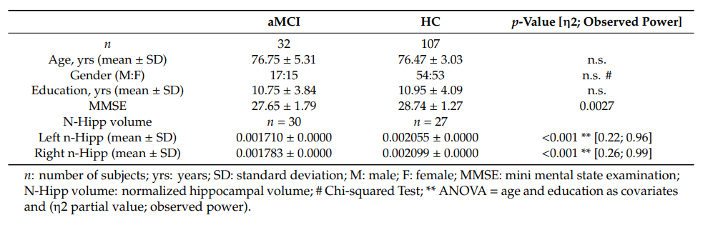

Slide 6
Materials and methods
2. Measure assessment
(1) Montreal cognitive assessment test (MoCA).
(2) Free and cued selective reminding test (FCSRT)
(3) The trail making test (TMT)
3. Serious Game Task: The Smart Aging Serious Game (SASG)
(1) SASG was performed using a touch-screen monitor and based on a virtual house, in which subjects interact with the different parts of the scenario and to perform specific tasks.
(2) Task 1 (T1), named “Object search”.
(3) Task 2 (T2), called “Water the flowers while listening to the radio”.
(4) Task 3 (T3), “Make a phone call”.
(5) Task 4 (T4), “Choose the right object”.
(6) Task 5 (T5), “Find the objects”.

Slide 7
Materials and methods
3. Serious Game Task: The Smart Aging Serious Game (SASG)
(7) We collected accuracy (accuracy index, AI) and time (time index, TI) measurements for each SAGS task.
(8) The sum of the total scores of all tasks was computed to calculate the Smart Aging Total Score (SASG-Total).

Slide 8
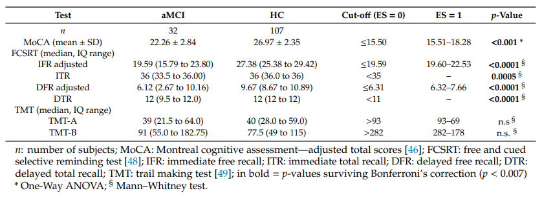
Results
1. Neuropsychological Assessment Results

Slide 9
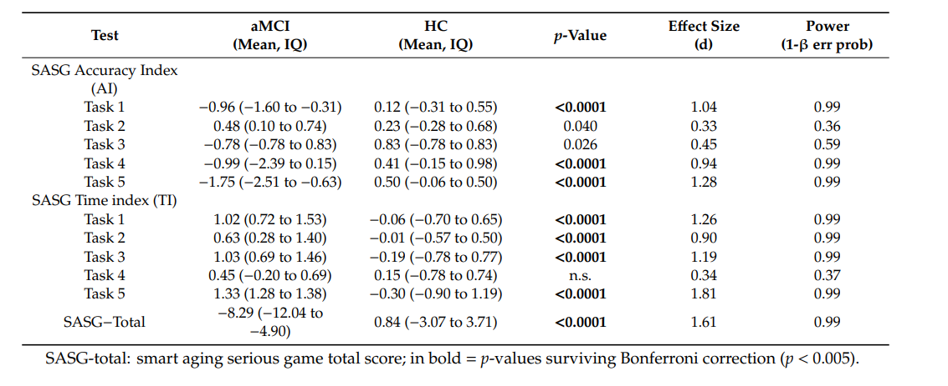
Results
2. SASG Results

Slide 10
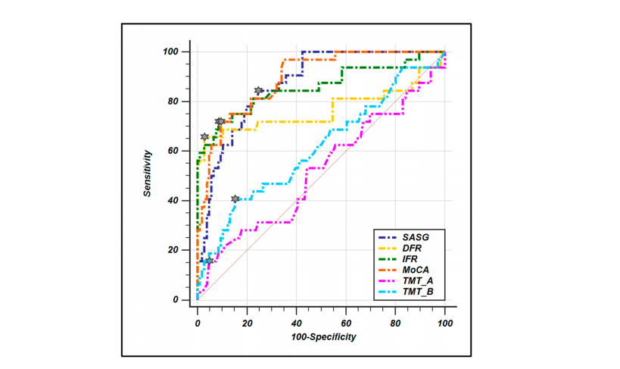
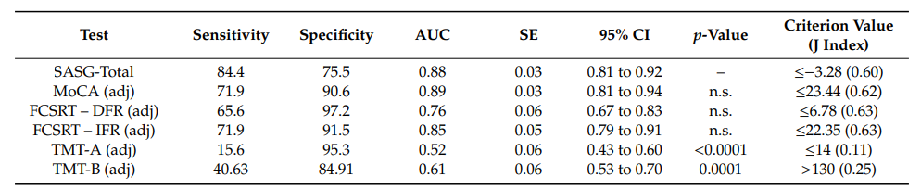
衡量疾病诊断标准好坏的两个指标
Sensitivity: 敏感性，将病人诊断为病人的概率
Specificity: 特异性，将健康人诊断为健康人的概率

Slide 11
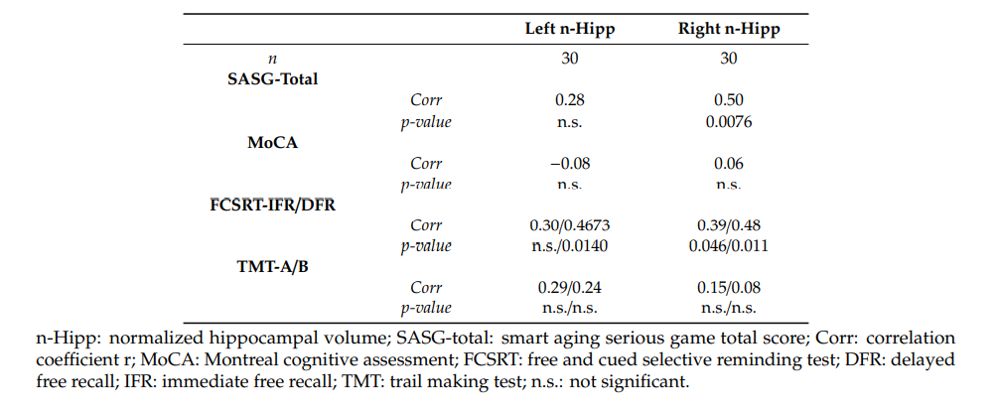
Results
3. SASG, MoCA and Hippocampal Volume

Slide 12
Discussion and conclusion
1. SASG has a very good performance (AUC: 0.879) in discriminating between groups, and these are statistically comparable to immediate and delayed recall of the FCSRT and to MoCA test.
2. SASG results in a significantly higher sensitivity and specificity when compared to the TMT.
3. SGSA is comparable to FCSRT and outperforms MoCA in the ability to detect the reduction in the hippocampal volume.
4. SASG represents an ecological tool for the timely detection of the functional impairment of this clinical condition.

Slide 13
下周计划
1. 改进系统，前往医院测试患者。
2. 阅读一篇论文。

